Slide 1
Flexible PCB’s Design and Stack-Ups
Presented by Royal Flex Circuits and Insulectro
Royal Flex Circuits: Bob Meyer – Larry Ybarra
And Insulectro: Chris Hunrath

Slide 2
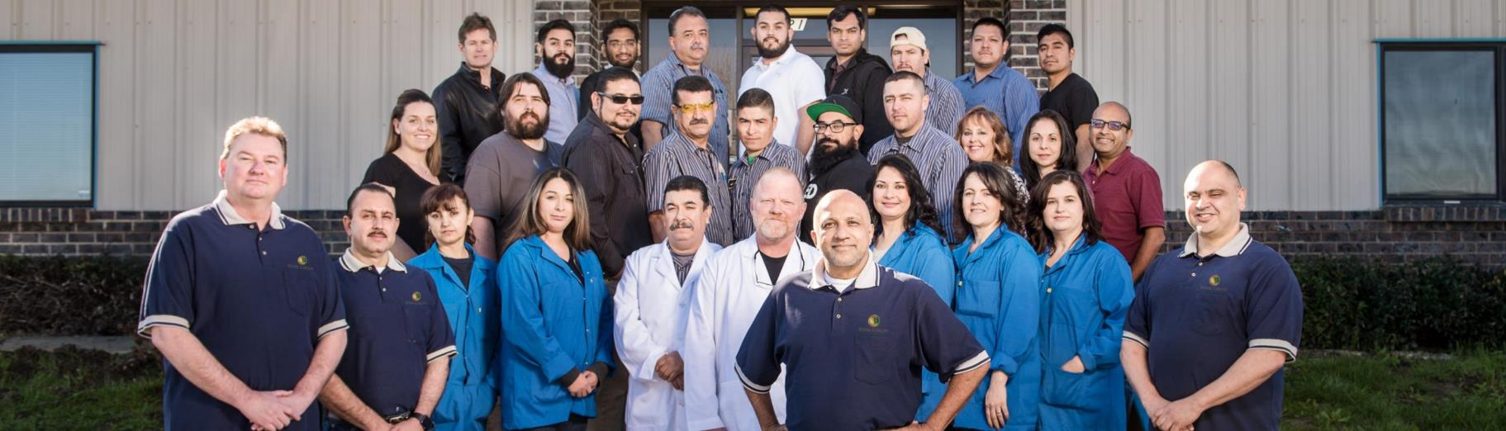
Royal Flex Circuits
Quick Turn PCB Flex & Rigid-Flex Specialist:
Over the last 30 years, Royal Flex Circuits has become the leader in quick-turn, high-tech PCB manufacturing – with no minimum order quantity. Using the latest technology and cutting-edge equipment, we are building the Factory of the Future with the capability to manufacture from the most basic to todays industry leading technology.

Slide 3
Royal Circuits Group
Royal Flex Circuits, in Santa Fe Springs, CA. is part ot the Royal Circuits Group, a highly recognized PCB company with manufacturing facilities in both Northern and Southern California. Royal Flex Circuits moved into a new, custom build production facility a little over a year ago, featuring the latest machinery, hardware and production methods.
Flex, Rigid-Flex, Rigid and Assembly
Santa Fe Springs, CA
Quick turn, specialty applications
Rigid
Hollister, CA
Quick turn, turn key, FR4, Polyimide, HSD and RF. Heavy copper (> 3.0 oz). Proto to production.

Slide 4
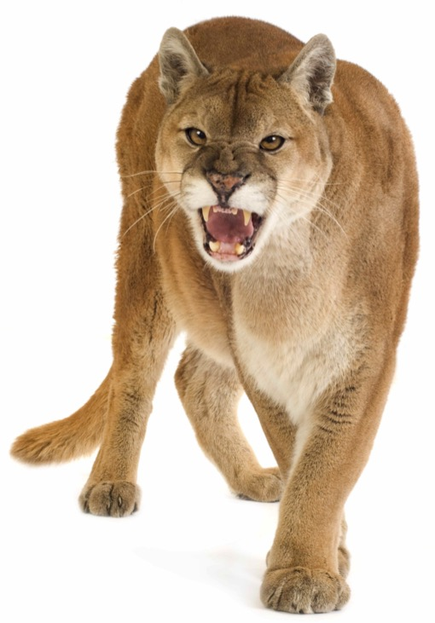
Insulectro: Electronic Materials
Offer a wide range of PCB materials from premier suppliers.
  Isola, DuPont, LCOA, CAC, Pacothane, Oak Mitsui, JX Nippon
Maintain the critical mass required to provide better access to products and technical support for the electronics industry.
  Provide Local Inventory
    Customers access material in hours
  On-site technical support
ACT! Accomplish Change Together
  Support fabricators with their customers
  Provide support for proper material selection

Slide 5
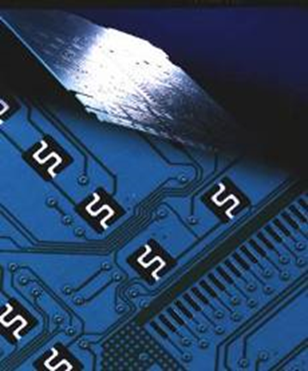
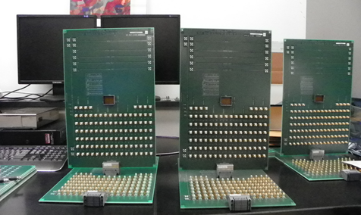
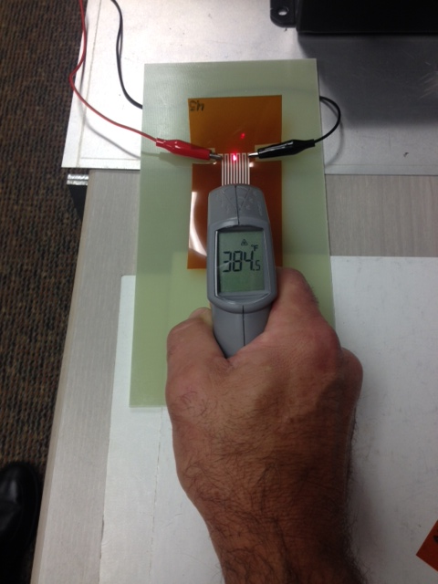
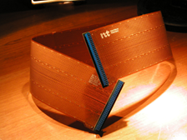
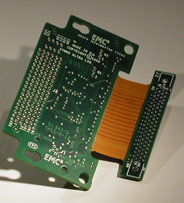
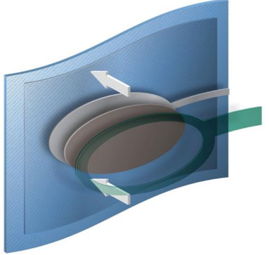
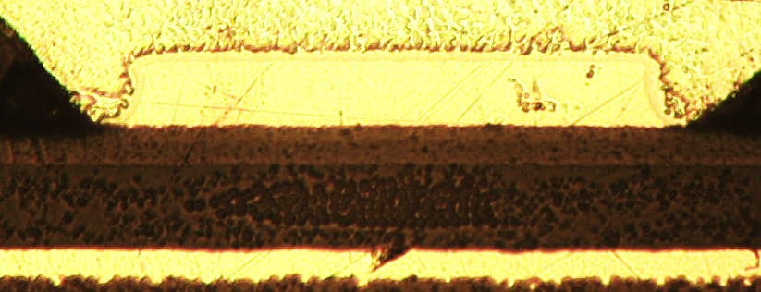
Materials for many technology Applications

Slide 6



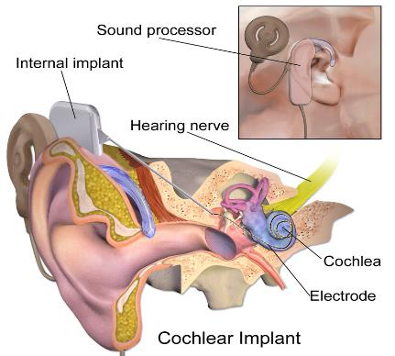

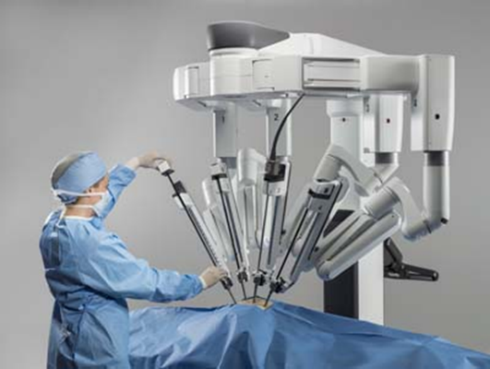
Why Flex?

Slide 7
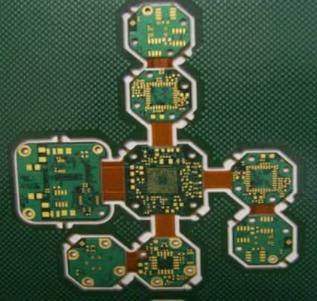
Bend to Install

Slide 8
Design Success
PCB’s are no longer simple replacements for wires.
They are an integral part of the design.
You don’t need to be material science experts.
Many of the new materials bring technology and/or performance advantages.
We are here to help.

Slide 9
Overview: Design Considerations
Bend to install or occasional flex or dynamic flex (and everything in between).
  Bend directions, bend axis
  Bend radius
Electrical
  Speed, frequency, bit rate, high current, high voltage
RF, noise, EM environment.
Operating temperature.
Use environment.
  Indoor, outdoor, medical, outer space, under hood

Slide 10
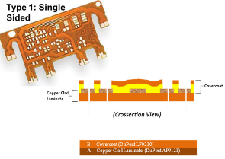
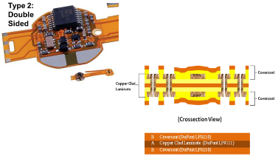
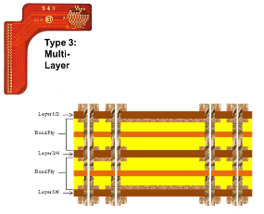
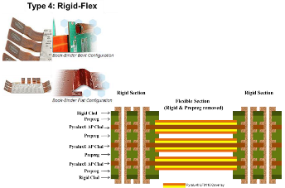
General Flex PCB Types

Slide 11
Cost Drivers: Stiffener vs Rigid Flex

Slide 12
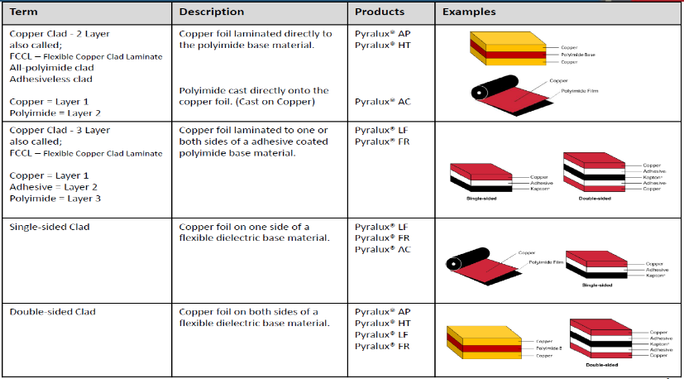
Flex Materials

Slide 13
Flex IPC Spec’s
Fab
  IPC-6013 (IPC-6012 for rigid)
Materials
  IPC-4202 – Base films
  IPC-4203 - Adhesive systems (Sheet adhesive, Coverlay, Bondply)
  IPC-4204 – Metal Clad dielectrics
  IPC-4562 – Metal Foils

Slide 14
Overview: Film Types
Type | Properties | Applications
Pyralux AP, AG and AC | Copper clad All Polyimide Film | Basic clad building block for circuits
LF and FR Adhesive | Acrylic Thermoset | Coverlay, bondply Multilayer
Pyralux GPL Adhesive (New) | Thermoset Epoxy Blend | Coverlay, bondply multilayer
Pyralux HT | Thermoplastic Polyimide | Coverlay, bondply High Temp, High Speed
Pyralux TK | Teflon/Kapton composite | Coverlay, bondply and clad Very High Speed

Slide 15
Bulk Properties of FPC Dielectric Films
Property | Unit | Method | Kapton® HN | Pyralux® AP | Pyralux® HT Bondfilm | Pyralux® TK | LCP
Thicknesses | mil | – | 1 - 5 | 1 - 6 | 1-4 | 2 – 4 | 1, 2, 4
Dk @ 10 GHz | – | Method 2.5.5.5 | 3.4 | 3.2 | 3.0 | 2.5 | 3.0 - 3.1
Df @ 10 GHz | – | Method 2.5.5.5 | 0.010 | 0.002 - 0.003 | 0.003 | 0.002 | 0.001 - 0.002
% Moisture uptake | % | Method 2.6.2 | 2.8 | 0.8 | 0.8 | 0.6 | 0.04
CTE (x-y axis) | ppm/°C | 50 to 250 °C | 20 | 25 | 25 | 27 | 18
CTE (z axis) | ppm/°C | 50 to 250 °C | 115 | 90 | 90 | 102 | 120
Peel strength | N/mm | IPC-TM650 | N/A | 2.0 (ED) 1.6 (RA) | N/A | 1.2 (RA) | 1.0 (ED) 0.4 (RA)
Tg | °C | DMA | 360 - 410 | 220 | 220 | 270 | –
Tm | °C | DSC | – | – | – | 300 | 280 - 315
Flammability | – | UL94 | V-0 | V-0 | V-0 | V-0 | V-0
Notes:
Consolidated Industrial product roadmap

Slide 16
Combination of the following;
  Material loss (Df)
  Conductor (Copper Trace)
    Trace roughness
    Trace width and thickness
    Trace Length
Signal integrity is often the most important need in a design.
As speed increases, loss becomes more important.
Total loss = Dielectric loss + Conductor Loss
Rolled Annealed Copper performs well at high speeds

Slide 17
Dk and Df of Pyralux Materials
Dk = 3.1 – 3.6
Df = 0.004-0.012
Dk = 2.9-3.5
Df = 0.02-0.03
Kapton® (The heart of AP and AG)
Dk and Df depends on…
  Type
    Type used in FR and LF Coverlay/Bondply is more lossy than that used in AP
  Orientation (normal or in-plane)
    Dk in-plane is higher than Dk normal
    Df about the same in both directions
  Environment (moisture level)
    Generally loss will increase significantly in humid
    environments if not encapsulated by copper.
    Dk will increase very slightly due to humidity (not significantly)
Acrylic Adhesive
  Huge frequency
  dependence for Dk (3.5 at MHz, 2.9 at GHz).
  Loss about 10 times more than Kapton® and 100 times more than Teflon®.
  High frequency applications should minimize the amount of acrylic in the stack-up.
Normal Dk is used in analysis

Slide 18
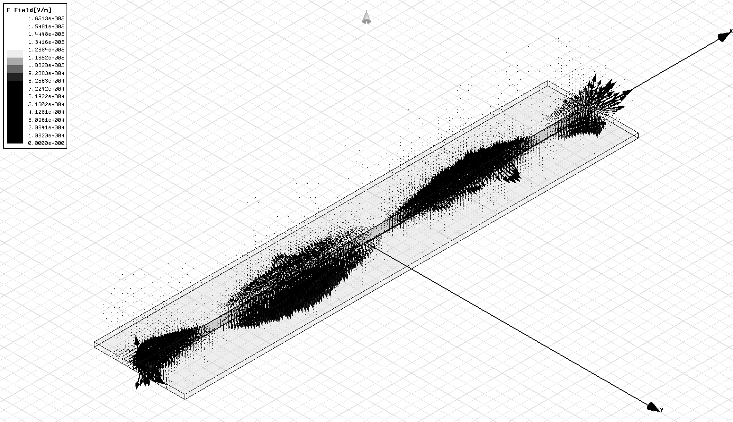
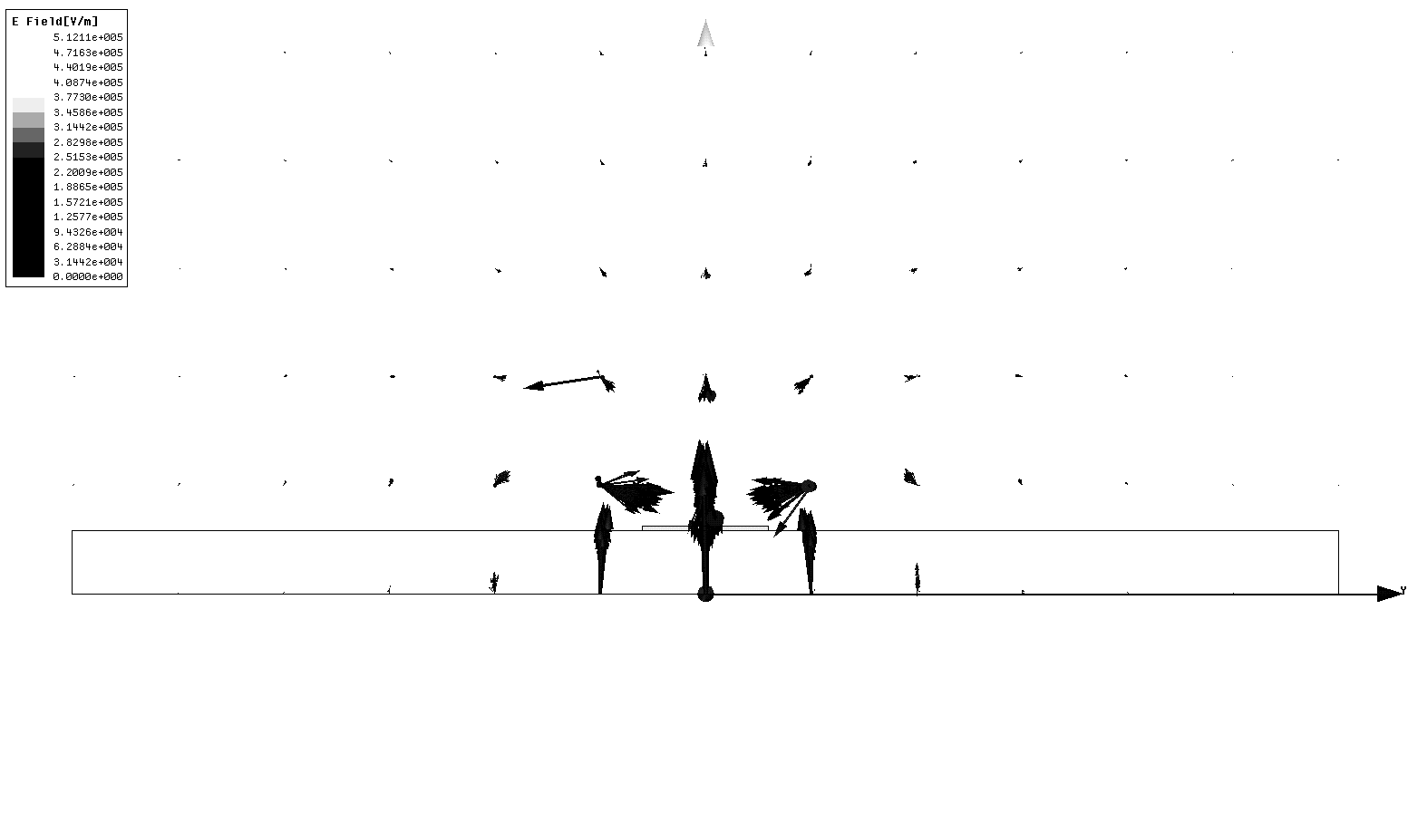
Microstrip Basics
Structure
  Two metal layers – ground and signal
    Usually a coverlay laminated to top and bottom (not shown here)
    Coverlay is a “necessary evil” to protect the copper.
    Slightly affects impedance and increases loss.
  Advantage: Lowest loss transmission possible
  with laminate materials.
  Disadvantage: Susceptible to outside noise
Fundamentals
  Signal is transmitted as WAVES of a changing electric
  field propagating through the dielectric
  More field lines pass through the clad than the coverlay.
  Impedance is determined by
    Dielectric constant
    Thickness of dielectric
    Width of line
    Thickness of copper
Electric Field Lines Shown
Coverlay
+
Signal
Clad
0
Ground
Loss is determined by
Structure Used
Copper Resistance
Roughness of copper
Loss tangent of dielectric

Slide 19
More Details on Microstrip
Determining Line Width
  Coverlay shown in this example.
  Fabricators generally adjust to get the impedance they need
  by adjusting the line width.
  They use software to do design calculations to tell them
  what widths to assign given certain thickness and
  dielectric constant values.
  The results of this analysis are design curves like the one shown
  in the following slide.
Estimating Loss
  At low frequencies (<100 MHz), the main thing that determines signal loss is resistance of the copper.
  Fundamentally, thinner laminates will have higher loss. Recall the initial “pipe” example. Similar reasoning why narrow pipes are more lossy.
  At RF frequencies – the copper resistivity, dielectric loss and roughness are all contributors to loss.
  At high frequencies (>10 GHz), the roughness of the copper has the biggest effect on loss.
Dk_{coverlay}
H_{coverlay}
T
Signal
W
H_{clad}
Dk_{clad}
Ground
Bottom coverlay not electrically active

Slide 20
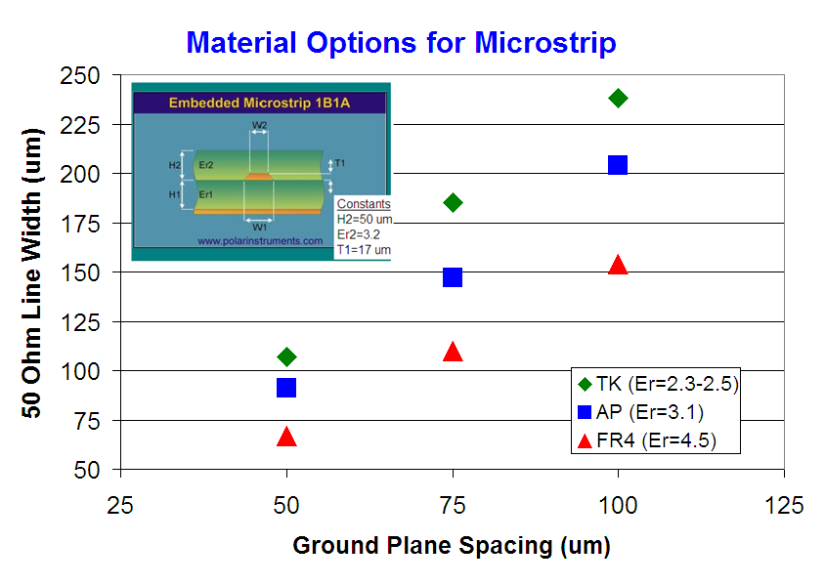
Effect of Dielectric Constant

Slide 21
Stripline Basics
Structure
  Three metal layers – ground-signal-ground
    Requires two laminations – one for bondply and the other for coverlay.
    More common in rigid-flex designs than microstrip.
  Advantage: Most noise-free structure since ground layers
  shield both top and bottom.
  Disadvantage: Thicker and higher loss than microstrip.
Things to Keep In Mind
  Stripline circuits need top and bottom ground planes to be tied together with vias.
  No electric field passes through the coverlay.
  Connectors are more difficult to implement with stripline, it may make more sense to use a rigid-flex approach to avoid use of connectors.
  Stripline has higher loss than microstrip due to the geometry and the fact that the line widths are normally narrower than microstrip.
Electric Field Lines Shown
0
Ground
Bondply
+
Signal
Clad
0
Ground

Slide 22
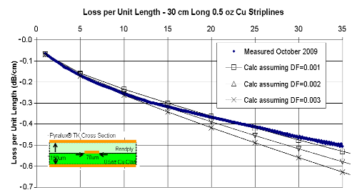
Copper Effects
High Frequency Effects
  As frequency increases, the current concentrates more and more toward the edges of the volume of the copper.
  When the roughness of the copper surface becomes close to the wavelength of the signal, the loss increases.
  This begins to be a big factor at frequencies of 10 GHz and higher.
  The plot does not suggest that the dielectric loss decreases, rather it indicates that low profile RA performs better than predicted.
Rules of Thumb
  Thicker copper has slightly lower loss and wider lines have lower loss.
  Effects of oxide treatments are hard to accurately predict, but generally only have an effect at higher frequencies.
  Skin effect has a bigger impact on stripline than microstrip since field is concentrated on top and bottom of line instead of mostly the bottom.
Cu Trace Cross Sections
(dark areas show highest field density)
Low frequency
High frequency
Higher Loss at High Speed
Lower Loss at High Speed
copper
copper
dielectric
dielectric

Slide 23
Low Profile copper Reduces Signal loss
SEM’s of copper foil surfaces from standard to VLP2
Yes, these are at the same magnification.
Smoother = lower loss
High performance laminates are a balance between signal performance and thermomechanical performance.
Typically, HVLP or VLP2 coppers come at a cost premium

Slide 24
Foil Grades from IPC 4562
Grade | Description
1 | Standard electrodeposited (STD-Type E)
2 | High ductility electrodeposited (HD-Type E)
3 | High temperature elongation electrodeposited (HTE Type E)
5 | As rolled-wrought (AR-Type W)
6 | Light cold rolled wrought (LCR type W)
7 | Annealed-wrought (ANN-Type W)
8 | As rolled-wrought low temperature annealable (LTA-Type W)
9 | Nickel, standard electrodeposited
10 | Electrodeposited low temperature annealable (LTA-Type E)
11 | Electrodeposited annealable (A-Type E)

Slide 25
Thickness and Width
For Microstrip, the benefits of lower Dk are not as significant.
  Line widths are always wider for microstrip than stripline.
  Having a lower Dk coverlay would make the difference a little bigger, but not by much.
  The main motivation for a Teflon® based coverlay would be to improve the loss…it would make a big difference here.
Low Dk has the biggest impact on stripline designs.
  The impact of a 2 mil vs 3 mil line
  width is MUCH bigger than the impact
  of a 6 mil vs 7 mil line width.
  The lower Dk directly affect yields
  if thickness is fixed.
  Lower Dk enables thinner designs
  in other cases.
LF Coverlay 1 mil
Cu 0.7 mil
H
Clad 1-5 mil in plot
Cu 0.7 mil
LF Coverlay 1 mil
LF Coverlay 1 mil
Cu 0.7 mil
1 mil adhesive between clads. Total internal dielectric
3-7 mil in plot.
Adhesive conforms to Cu
H
LF Coverlay 1 mil
Cu 0.7 mil

Slide 26
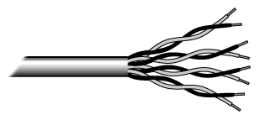
Differential Pairs
UTP Cable
What they are
  Two lines coupled together. They are either called “+” / “-” or “signal” / “return”.
  Example: Phone Lines – wires twisted together.
  Phone cable can be unshielded (like the one shown) or shielded
  with foil wire wrap.
Why use them?
  A changing current (aka “a signal”) will induce currents on nearby wires or traces.
  This is called “crosstalk” – probably have experienced it on telephone conversations.
  Coupling the signals together minimizes crosstalk due to the coupling (see electric field lines).
  Noise that is common to both “+” and “-” are much weaker than the coupling between the two signals.
  Stripline geometry provides the most immunity from external noise similar to the way shielded versus unshielded phone cable.
Differential Microstrip
+
-
0
Differential Stripline
0
+
-
0

Slide 27
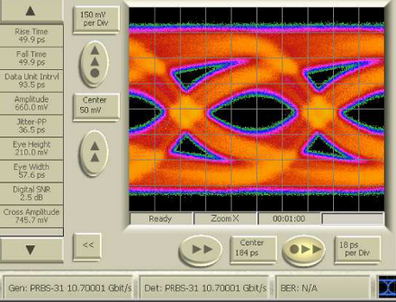
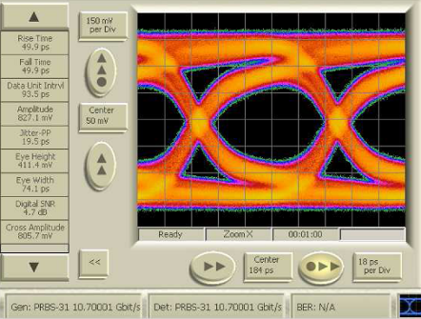
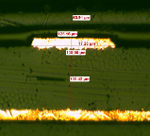
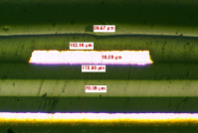
Eye Pattern Testing on Covered MS Lines
REAL measurements. Not simulations (usually what you see).
FR4 – 4 mil Thick Pyralux® TK – 3 mil Thick
50 ohm, 200 mm Long 50 ohm, 200 mm Long

Slide 28
Flexible Circuit Materials: General Guidelines
Use adhesive-less clads, AP and AG for most applications.
Use acrylic adhesive for most applications.
  Cost, Availability, Flexibility, ease of process
When not to use acrylic adhesive
  Low loss, high operating temperature
Use Rolled Annealed copper.
  Flexibility, Availability
For very thin (>9 micron) coppers, use ED foil

Slide 29
Flexible Circuit Materials: Low Loss, High Speed
Polyimide films like Pyralux AP and AG outperform many rigid PCB materials – Df of 0.0030 and 0.0035 respectively
Acrylic adhesive is around 0.0250
The new GLP adhesive is 0.0035
The HT bondsheet is 0.0030
The TK bondply is 0.0020
Note: HT and TK require special lamination conditions at the fabricator.

Slide 30
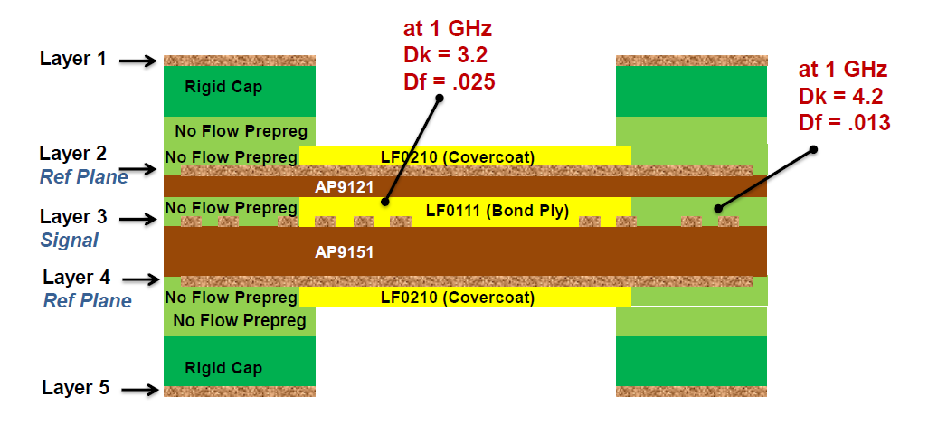
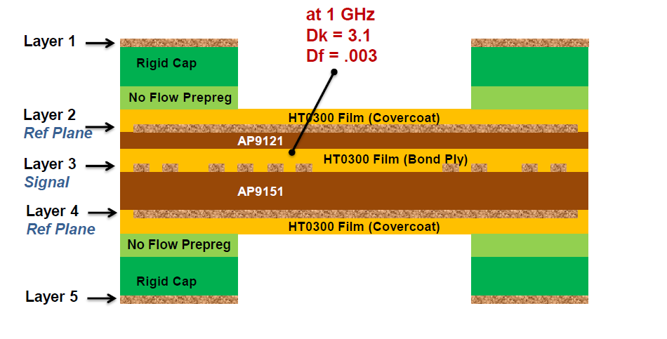
Current Rigid/Flex Stripline with AP/LF “bikini” construction
Rigid/Flex Stripline build with AP Clad and HT Film

Slide 31

ROYAL FLEX CIRCUITS
Design for fab, Design for success!
Flex Building Blocks
Royal Flex Circuits EngineeringTeam will make recommendations for the best stack-up based on the design.

Slide 32
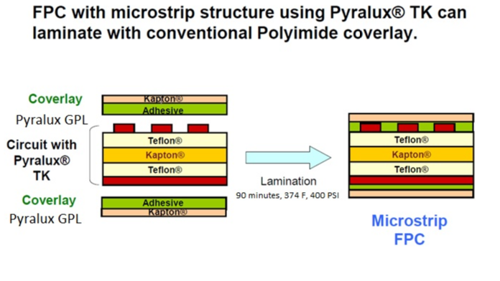
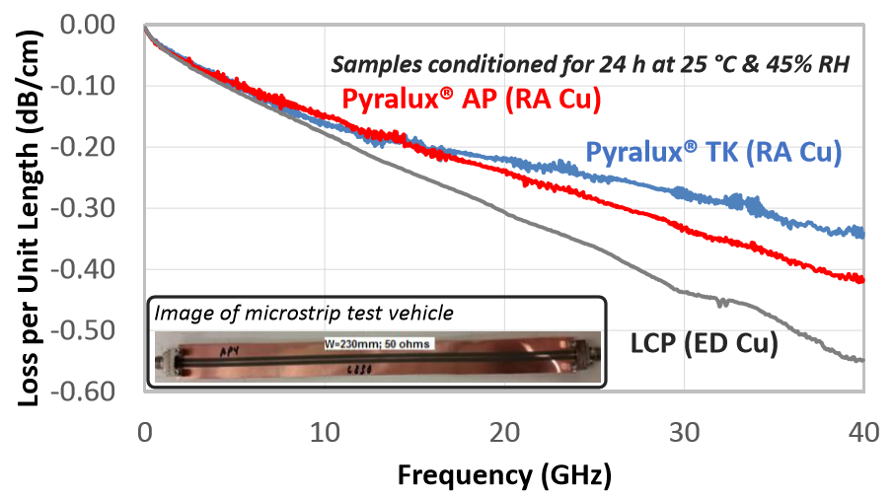
Pyralux TK and GPL
A low loss solution without needing investments
GPL has great loss characteristics, and does not require high temperature lamination like HT does.
A combo of TK and GPL would yield a very low loss board without needing special processing requirements.
Products | DK | DF
Pyralux GPL | 2.8 | 0.0035
Pyralux TK | 2.5 | 0.002
* Would need to laminate GPL to Kapton, coverlay option of GPL coming later in 2020.

Slide 33
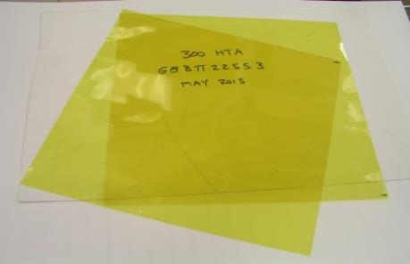
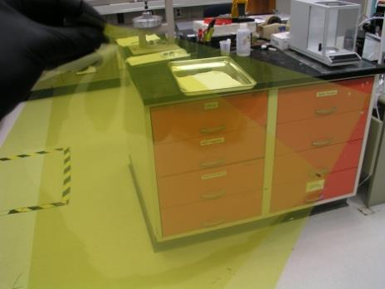
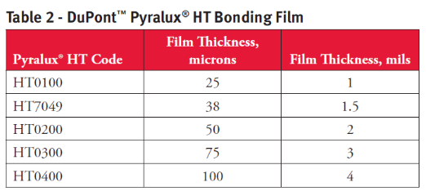
HT Bonding Film – Used for Bondply or Coverlay
Homogeneous thermoplastic film.
  Similar to thermoplastic layer of AP or HT clad
  No curing or cross-linking involved
  Very viscous – no flow
Multi-Functional: Bondply or Coverlay
  No reinforcing film required due to high viscosity
  Different thicknesses available (1-4 mil)
Very good High Frequency Performance
  No Acrylic!
  Dk=3.2, Df=0.003
  Low moisture absorption

Slide 34
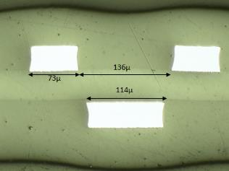


Examples – HT as a Coverlay
HT9121R with HT0300
  - DS 1 oz Cu over 2 mil PI
  - 3 mil HT Coverlay
HT8525R with HT0200
  - DS 0.5 oz Cu over 2 mil PI
  - 2 mil HT Coverlay
HT9121R with HT0200
  - DS 1 oz Cu over 2 mil PI
  - 2 mil HT Coverlay
34

Slide 35
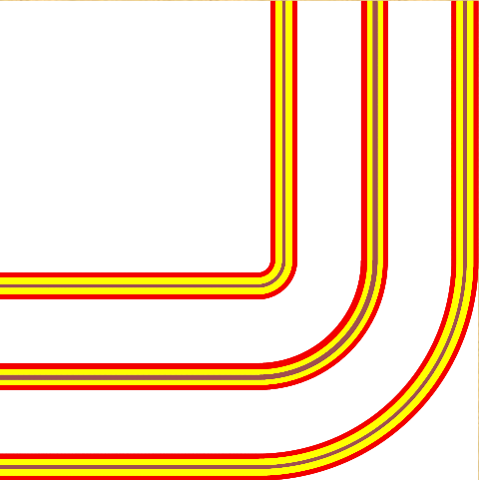
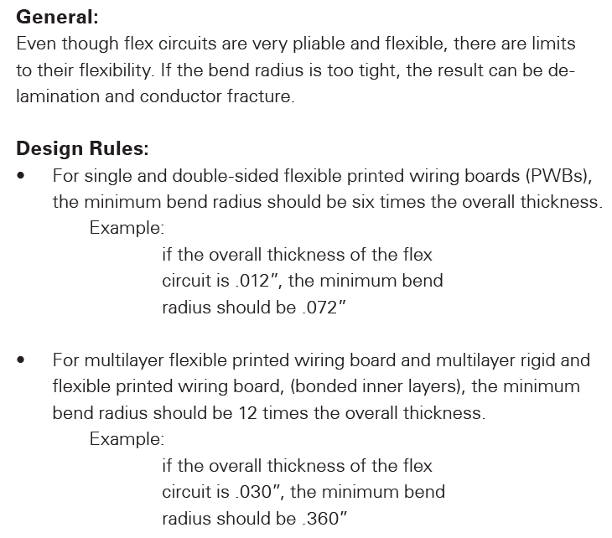
Bend Ratio = Bend Radius : Thickness
10:1 Single Sided
10:1 Double Sided
20+:1 Multi-Layer

Slide 36
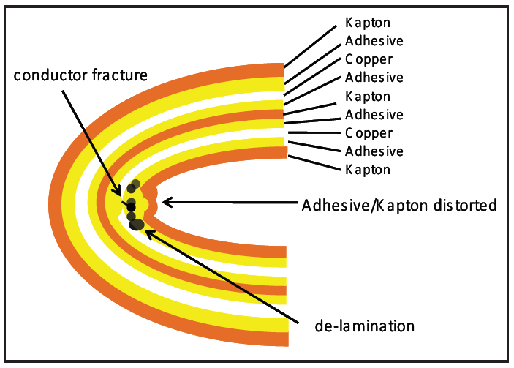
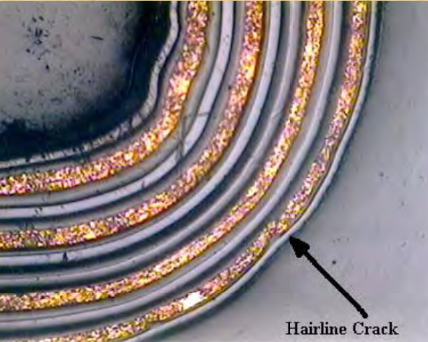
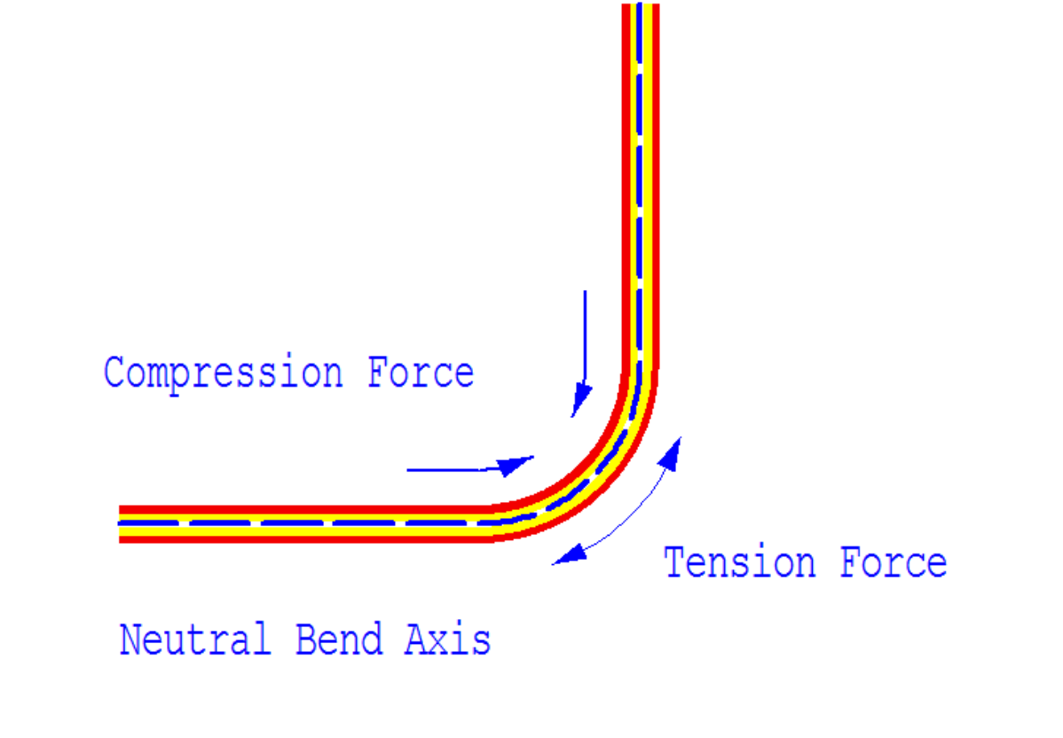

Slide 37
Bend Area: General Guidelines
Keep single plane layer near center of stack-up.
Keep signal layers (traces) inside (concave side) of bend axis.
Use “loose leaf” constructions for multilayer flex in rigid flex.
No PTH’s in bend area.
Rout traces 90° to bend axis in bend area.
Avoid “I-Beam” routing of traces.
Use “cross hatch” reference places when possible.

Slide 38
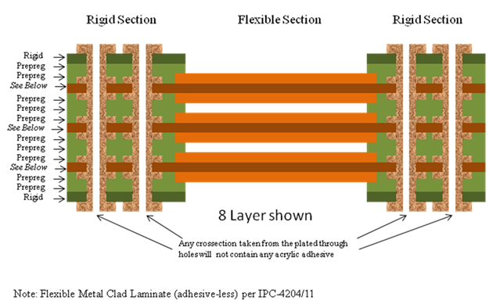
“Loose Leaf” Rigid Flex
No bonding between coverlays

Slide 39
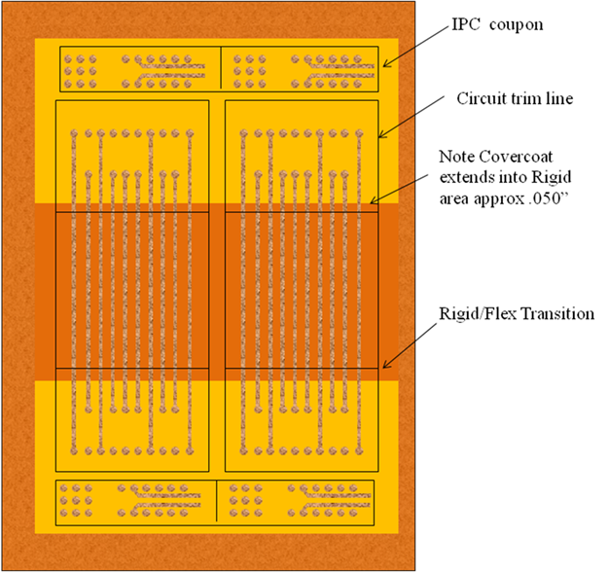
Bend Area for Rigid Flex
Bend Area

Slide 40
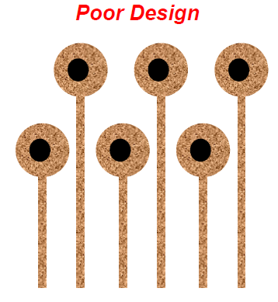
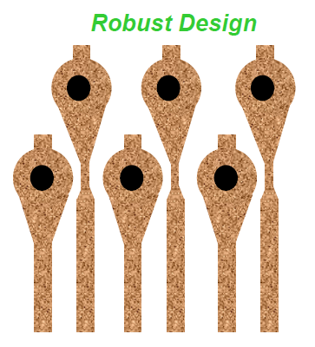
Use of Stress Riser and Fillets
Risk of crack

Slide 41
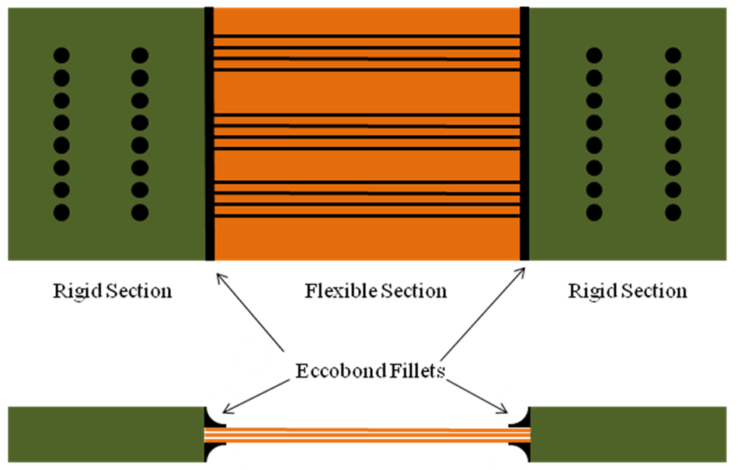
Ecobond Fillets for transition stress relief

Slide 42
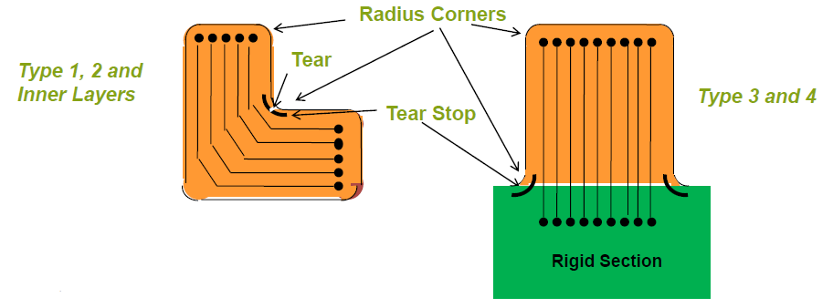
Tear Stops and No Square Corners or Sharp Edges

Slide 43
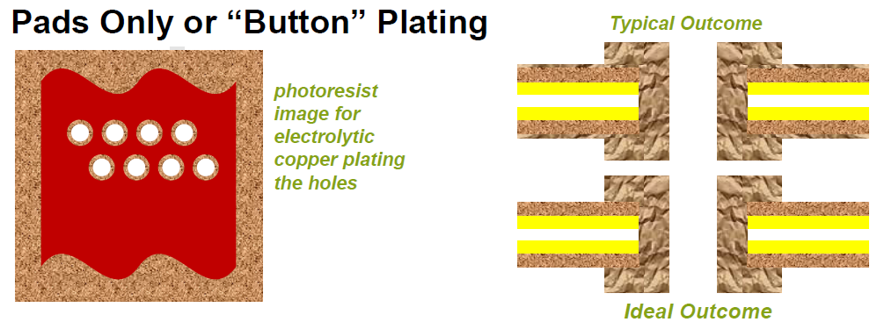
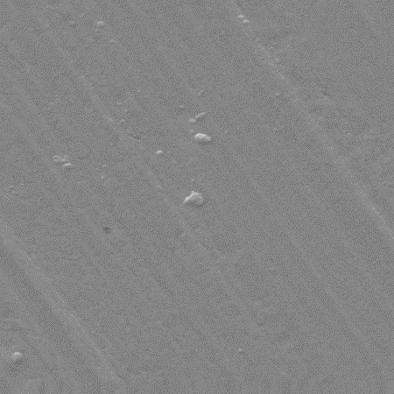
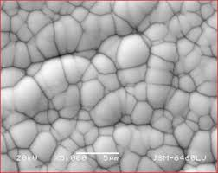
Plating: Holes and Pads= OK, but don’t Plate Traces
Rolled Annealed Copper
Electroless
Nickel SEM

Slide 44
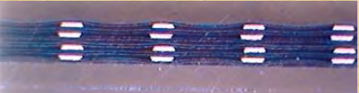
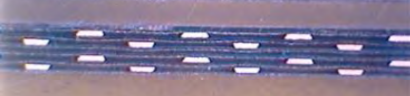

Avoid “I-Beam” Circuit Lay-out
Not This This

Slide 45

Can closely estimate impedance from stackup
  Take note of required values
    Dielectric Thickness, Copper Thickness, Copper Widths, Coverlay Thickness
    Dielectric Constant of Clad, Dielectric Constant of Coverlay, Spacing Between Lines
Cross Hatched Ground Planes
  Significantly increases impedance
  Shielding may poorer as a result
  If ground plane is gridded, then find out
    Width of Hatches (HW)
    Pitch of Hatches (HP)
    Angle (default is 45 degrees)

Slide 46

Crosshatched Reference Planes
Good for assembly
*Moisture egress
Good for Flexibility
Has signal performance limitations

Slide 47





Reference Plane design (12” x 18”)

Slide 48

Stripline – Passband/Stopband

Slide 49


Pyralux APR
Embedded Resistors
  Film under copper foil
  Selectively etched to form resistors
Series resistors

Slide 50
Wrap-Up
Flex is growing;
Medical, Aero and outer space, Automotive, etc.
Speeds and low loss needs are increasing.
Many applications for electronics are possible;
Work with the fabricator early
New materials
AG, GPL, HT, etc

Slide 51
Special thanks to:
Royal Flex Circuits Team
DuPont Electronic Solutions
Dale Smith

Slide 52
Questions?
Email Lisa@royalcircuits.com, riki@royalflexcircuits.com or CHunrath@Insulectro.com with additional questions

Slide 53
Thank you!
– Royal Flex Circuits
Chris Hunrath – Insulectro

